Slide 1
Design & Architecture
Comparisons
Anthonie Roux, Sean McClanahan,
Kwok ho Lo, Michael Haufe

Slide 2
Project Overview
Contact Swap is an android application that makes it quick and easy to exchange your contact information with anyone you meet. Just touch the phone of your nearest friend's phone and you're double plus friends!
There are different ways to implements this application. In different field of technologies we are using( from communication mobile platform, we will cover two designs of each, pros and cons, and why we choose the final designs.

Slide 3
Design Decisions
Communication Technology
Mobile Platform
Contact book management
User Identification
Runtime design

Slide 4
Communication Technology: NFC
Pros:
Flows with social interaction
Low power consumption
Simple interface, no device filtering
No network requirement
Cons:
Lower data transfer rate
Two devices must be in NFC range
Device restrictions

Slide 5
Communication Technology: WiFi
Pros:
No hardware restrictions
Long distance transfer
Higher transfer rate
Cons:
WiFi connection required
Must search for contact target

Slide 6
NFC
NFC works better with our vision of face-to-face interactive contact exchange

Slide 7
Mobile Platform: IOS
Pros:
Nicer programming IDE (Xcode)
iPhone 6 now supports NFC
consistent platform, easy to use
Cons:
group owns no ios devices
only iphone 6 has NFC
expensive and complicated to publish to app store

Slide 8
Mobile Platform: Android
Pros:
group already familiar with Java and XML
Many devices supporting NFC
Much easier to publish app
Cons:
non-Consistent, many more possible devices has to test on

Slide 9
Android
programming language knowledge, no ios devices to test with

Slide 10
Manage our own contact book
Pros:
More control of the contact format
Consistent format across devices
Everything managed through one app
Cons:
More development effort
Duplicate address books
Syncing issues involved

Slide 11
Using Device’s built-in contacts
Pros:
Ready-made API
Contacts are decoupled from the application
Native syncing feature
Meets user expectations
Cons:
Less control of contact format
Metadata (privacy) is stored separately
Dependant on API versioning

Slide 12
Device’s contact book
Less development, User expectations

Slide 13
User Identification: unique key
Pros:
Independent of personal contact info
Prevent falsification
All fields can have privacy settings
Cons:
Need infrastructure to generate unique keys
Syncing and reinstalling issues

Slide 14
User Identification: phone number
Pros:
Works well as a personal identifier
No separate infrastructure required
Cons:
Cannot modify phone number
Must share phone number

Slide 15
Phone number
No separate Infrastructure

Slide 16
Runtime: Background process
Pros:
Swap are automatically initiated
user will be less likely to forgot the app
Cons:
Performance impact
Accidental Initiation

Slide 17
Runtime: User must initiate
Pros:
Saves power
Less of a privacy concern
Saves on system performance
Cons:
Slight user inconvenience

Slide 18
User must Initiate
saves power, less privacy concern

Slide 19
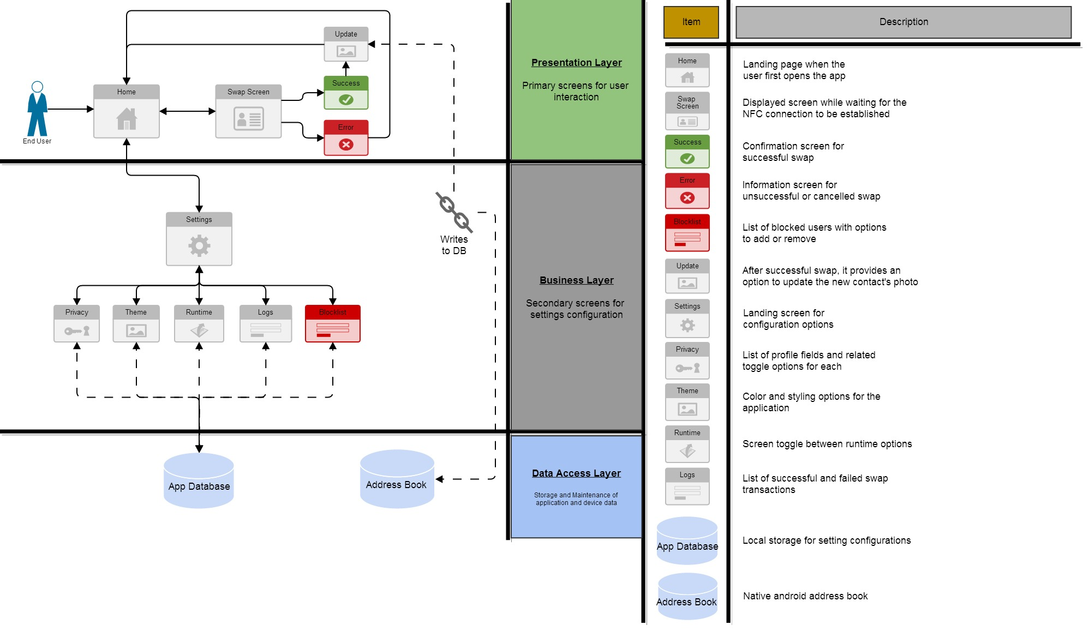
Architecture 1

Slide 20
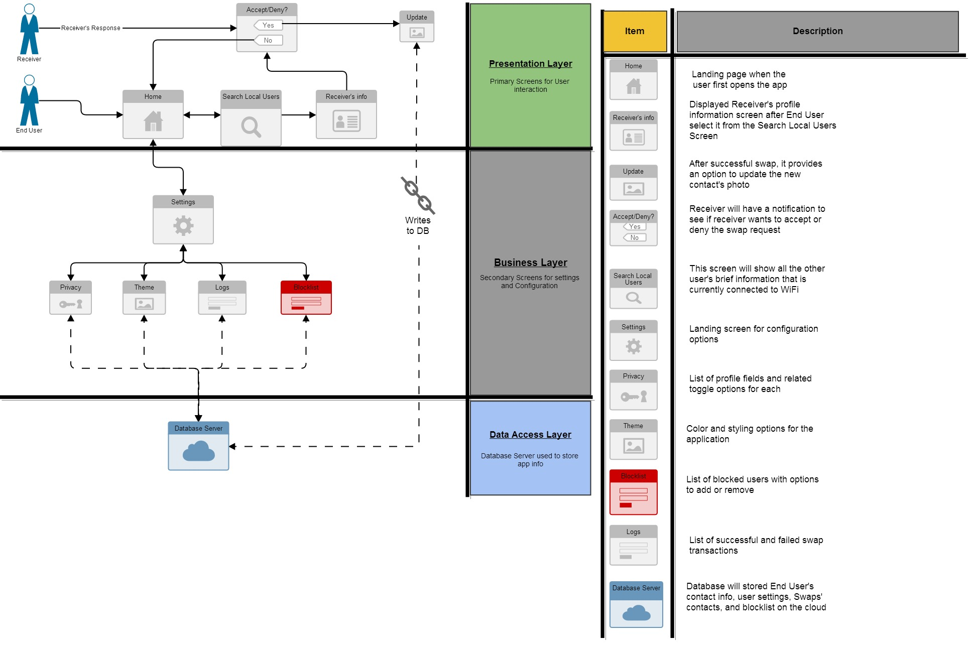
Architecture 2

Slide 21
We chose Architecture 1
Meets expectations of the end user, and provides the best security

Slide 22
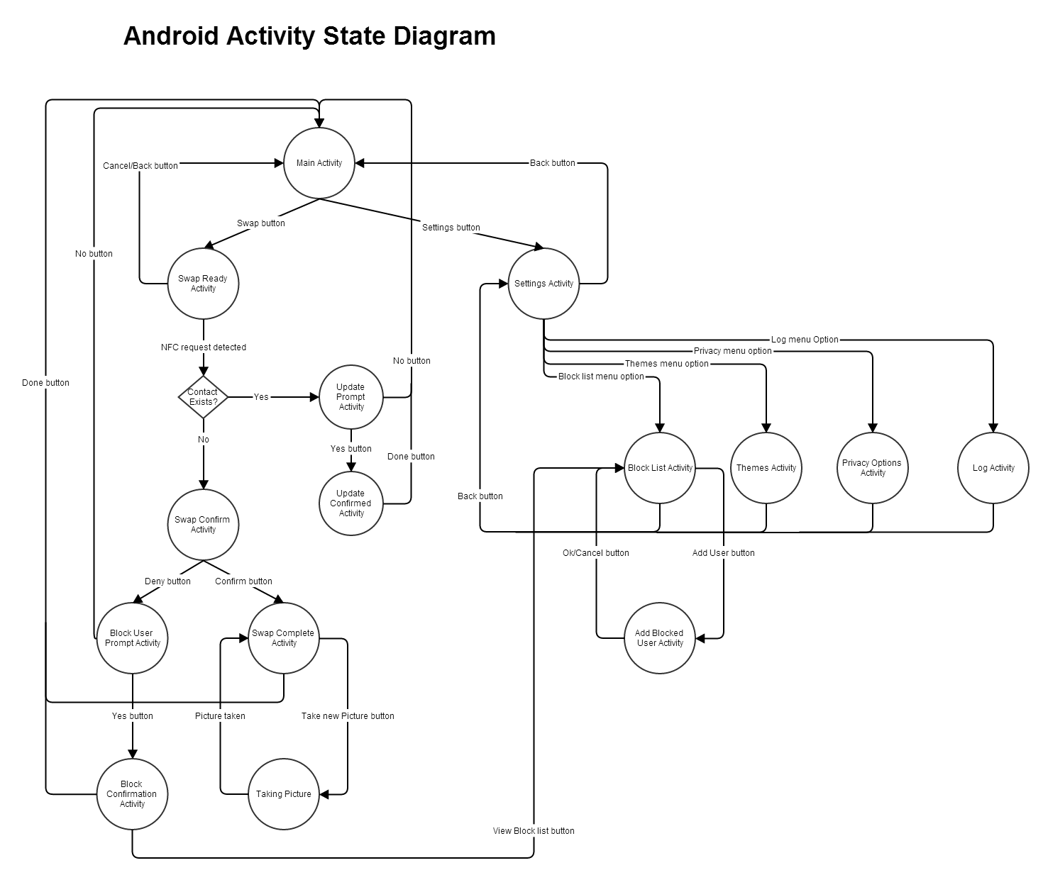

Slide 23
Sprint 1
NFC Development
Sharing Basic Info
Phone number, name, profile picture
Basic User Interface
Privacy Toggle

Slide 24
Sprint 2
Runtime
Blocklist
Logs
Profile Photo capture Activity
Contacts

Slide 25
Sprint 3
Social Media API’s
Theme

Slide 26
Member Roles
 | Development | User Interface | NFC | Documentation | Testing and Integration | Donuts
Anthonie Roux | x |  |  | x | x
Sean Mcclanahan | x | x |  |  | x
Kwok ho Lo | x |  | x
Michael Haufe | x | x |  | x |  | x

